Slide 1


Powerpoint Templates
Powerpoint Templates _{Page 1}
Mobile Databases
Presented by Lucy Kurbah
Roll no 29

Slide 2
Contents
Powerpoint Templates
Introduction
Mobile database
Types of mobile database
Characteristics
Existing mobile databases
Reference

Slide 3
Why Mobile Databases?
Powerpoint Templates
Mobile data-driven applications enable us to access
any data from anywhere, anytime.
Examples:
Salespersons can update sales records on the move.
Reporters can update news database anytime.
Doctors can retrieve patient’s medical history from anywhere.
Mobile DBMSs are needed to support these applications
data processing capabilities.

Slide 4
Mobile Database:
Powerpoint Templates
A mobile database is a database that can be connected to by a mobile computing device over a wireless mobile network.
Mobile databases:
Physically separate from the central database server.
Resided on mobile devices.
Capable of communicating with a central database server or other mobile clients from remote sites.
Handle local queries without connectivity.

Slide 5
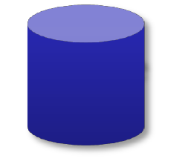








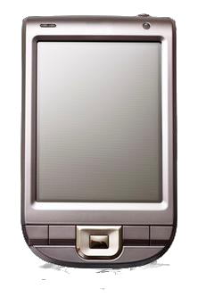

Client-Server Mobile Databases:
Powerpoint Templates
Mobile DB
Laptop
Central Server
Mobile DBMS
Central Database
Central DBMS
`
Mobile DBMS
Mobile DB
Smartphone

Slide 6
Client-Server Mobile Databases:
Powerpoint Templates
Client-server model
information systems.
is the traditional
model of
It is the dominant model for existing mobile databases.
The server can become a single point of failure and performance bottleneck.
Even storing data on a cluster of machines to backup central database might cause performance bottleneck and data inconsistency.

Slide 7


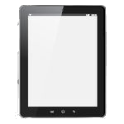






Peer-to-Peer Mobile Databases:
Powerpoint Templates
Mobile DB
Laptop
Tablet
Mobile DB
Mobile DBMS
`
Mobile DBMS
Mobile DBMS
Mobile
DB
Smartphone

Slide 8
Peer-to-Peer Mobile Databases:
Powerpoint Templates
In P2P mobile databases, the database maintenance
activities are distributed among clients.
Every process plays part of the role of the server, besides its client role.
A client that wants to access a piece of data, sends a request to other peer clients and they forward the request until the data is found.
The major problem in this model is ensuring the availability of data .

Slide 9
Characteristics of Mobile Environments:
Powerpoint Templates
Characteristics of mobile environments:
Restricted bandwidth of wireless networks.
Limited power supply.
Limited resources.
Mobility.
Disconnections.

Slide 10
Requirements of Mobile DBMSs:
Powerpoint Templates
Mobile DBMSs
requirements :
should
satisfy
the following
Small memory footprint.
Flash-optimized storage system.
Security.
Low power consumption.
Self-management.
Embeddable in applications.

Slide 11
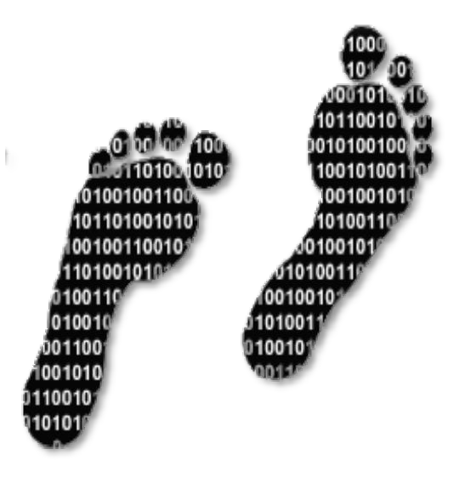
Small Memory Footprint:
Powerpoint Templates
Memory footprint is amount of main memory that an application uses while running.
Mobile devices have limited memory, so the mobile database application should have a small footprint.
The size of mobile database affects
application footprint .
the overall
Mobile DBMSs should be customizable to include only the required database functionalities.

Slide 12


Flash-Optimized Storage System:
Powerpoint Templates
Flash memories are dominant storage devices for
portable devices .
They have feature such as:
Small size.
Better shock resistance.
Low power consumption.
Fast access time.
No mechanical seek and rotational latency.
Mobile DBMSs need to be optimized to exploit the
advantages of the new storage devices.

Slide 13


Security:
Powerpoint Templates
Security is very important for data-centric mobile applications.
It is more important when the application works with critical data that its disclosure results in potential loss or damage.
Data that are transmitted over a wireless network are
more prone to security issues.
Mobile DBMSs should implement a complete end-to-
end security to ensures the secure transfer of data.

Slide 14

Low Power Consumption:
Powerpoint Templates
Portable devices have limited power supplies.
Processor, display and network connectivity are the
main power consumers in a mobile device.
Mobile DBMSs need to be optimized for efficient power consumption.

Slide 15

Self-Management:
Powerpoint Templates
In traditional databases,
the database
administrator (DBA) is
databases maintenance.
responsible for
In mobile DBMSs there can be no DBA to manage the database.
Mobile DBMSs need to support self-management and automatically perform the DBA tasks.
Some mobile DBMSs allow remote management that enables a DBA to manage the mobile databases from a remote location.

Slide 16

Embeddable in applications :
Powerpoint Templates
Administrators does not have access to mobile devices.
direct
Mobile DBMSs should be an integral part of the application that can be delivered as a part of the applications.
The database must be embeddable as a DLL file in the
applications.

Slide 17
Existing Mobile Databases:
Powerpoint Templates
Mobile databases:
Sybase SQL Anywhere
Oracle Lite
Microsoft SQL Server Compact
SQLite
IBM DB2 Everyplace (DB2e)
Embedded database:
TinyDB
PicoDBMS

Slide 18
References:
Powerpoint Templates
Nori, A. Mobile and embedded databases. In Proc. SIGMOD 2007, ACM Press (2007), 1175-1177.
Tsiftes, N. and Dunkels, A. A database in every sensor. In Proc.
SenSys 2011, ACM Press (2011), 316-332.
Whang, K.Y., Song, I.Y., Kim, T.Y., and Lee, K.H. The ubiquitous
DBMS. ACM SIGMOD Record 38, 4 (2009), 14-22.
Sen, R. DBMS techniques for lightweight computing devices. In
Proc. MobiDE 2011, ACM Press (2011), 1-8.

Slide 19

Thank You
Powerpoint Templates

